Slide 1
Encoded Layer

Slide 2
Encoded Layer - Representation
By reducing neuron at the “code” layer from 40 to 24, we observe a drop of accuracy in final classification result as well as value loss at the autodecoder.
This is due to essential features can be under-represented by limited number of neurons.
Hence, making a choice to set “code” layer at 40 to prevent excessive under-representation of the features.

Slide 3
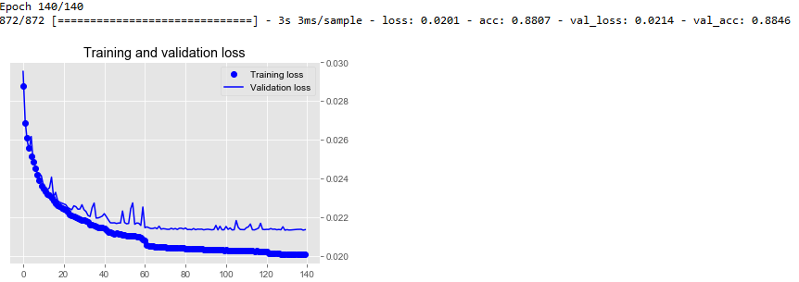
40 neurons at “code” layer

Slide 4
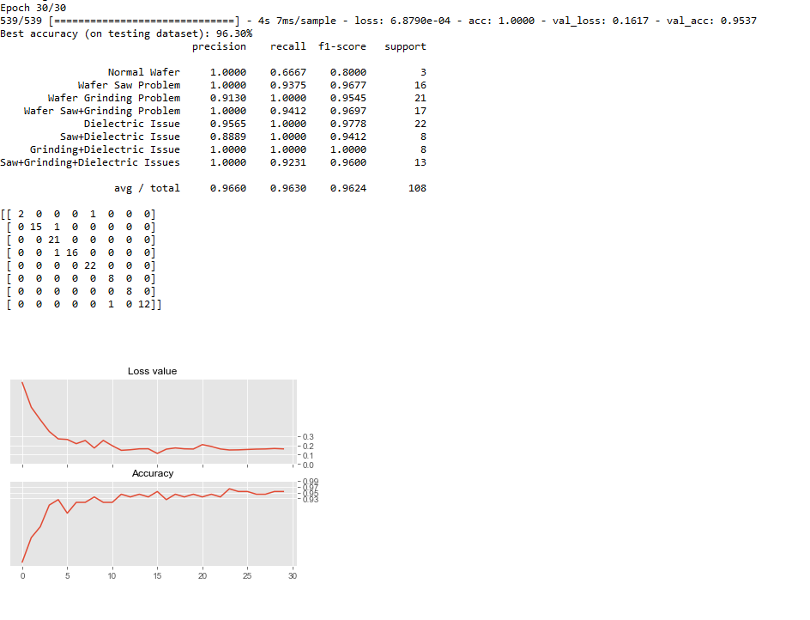

Slide 5
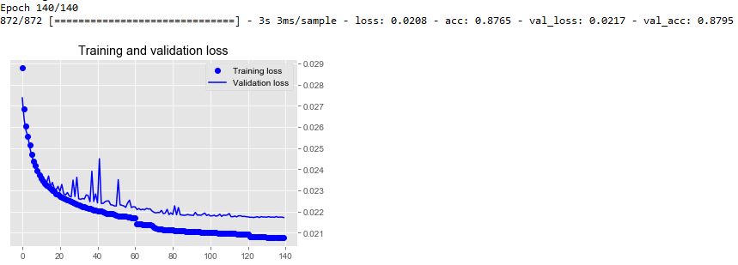
24 neurons at the “code” layer

Slide 6
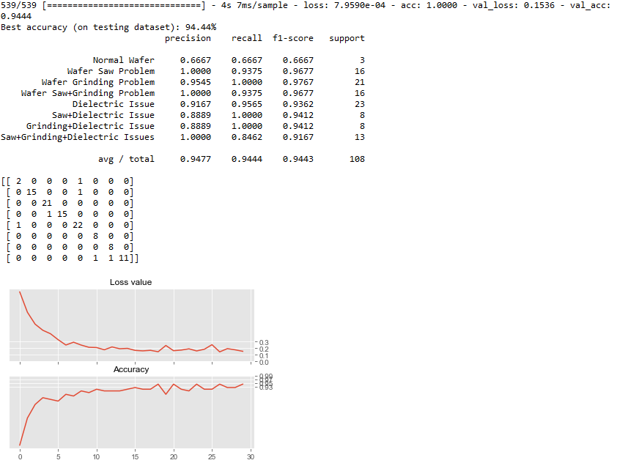

Slide 7
Learning Rate Curve

Slide 8
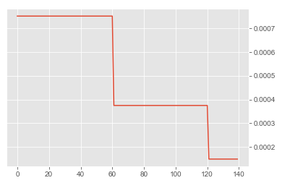
Autodecoder Learning Rate
140 epochs with 2 step learning rate reductions. This allow the loss curve to be less spiky in the learning process.￼
￼

Slide 9
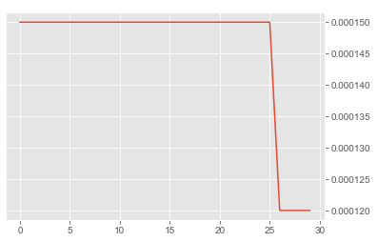
Classifier Learning Rate
30 epochs with reduced learning rate at the last 5 epochs to stabilize the result.

